Slide 1
A CNN-based Machine Learning
for Image Classification Application
FENG Xuezhi (2030026034) FENG Ziao (2030026036) PENG Rongwei (2030026116) QIAN Jingbin (2030026117) ZHENG Yuguang (2030026217)
Group 6

Slide 2
TABLE OF CONTENTS
01
02
03
04
Introduction
LeNet
AlexNet
VGG Net
05
ResNet
06
07
08
EfficientNet
Application
Conclusion

Slide 3
01
Introduction

Slide 4
Concept of Convolutional neural network
CNN, which is a feed-forward neural network, has a convolution structure. Through the deep network, the operation of convolution can reduce the memory occupied.

Slide 5
Three main operations
Pooling layer
02
Convolution layer
01
Fully-connected layer
03
is a down-sample process that improves the speed of operation, and improves the robustness of the extracted features.
is an operation that gets the inner product between the image and the filter matrix.
is responsible for converting the two-dimensional feature map of the convolution output into a vector of one dimension

Slide 6
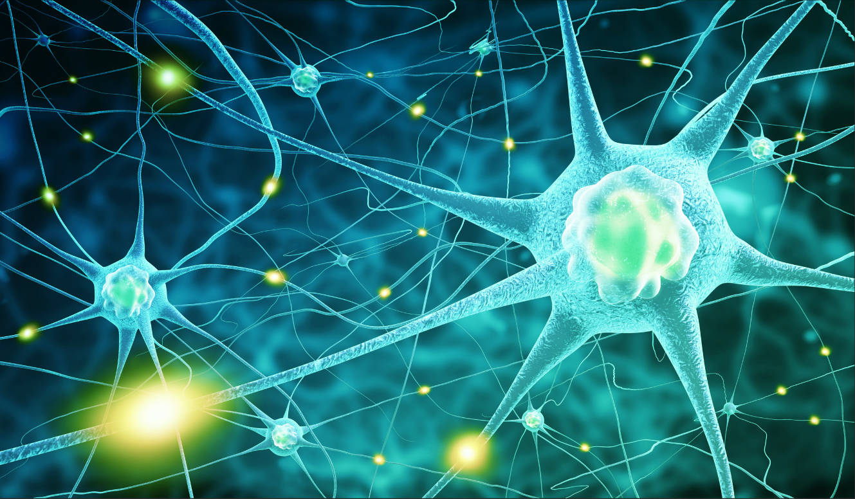
The birth of CNN
(1) Expanding the image into vectors will loss of spatial information;
(2) Too many parameters are inefficient and difficult to train;
(3) A lot of parameters can quickly lead to over-fitting of the network.

Slide 7
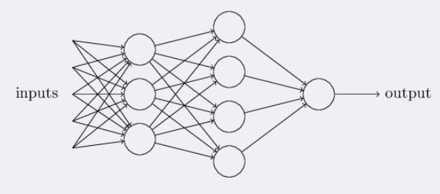
Structure of CNN
The most common structure of a convolution neural network :
Neural network
The most common form of a convolution network is to put some convolution layers together with the activation layers, followed by a pooling layer, and repeat this until the image is spatially reduced to a size small enough that it transitions to a fully-connected layer somewhere. The final fully-connection layer is the output.

Slide 8
Lenet5
02
The first successful convolutional neural network.

Slide 9
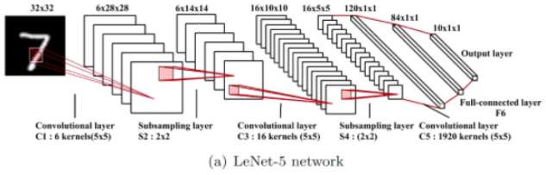
Introduction to Lenet
It is one of the earliest CNN, which promotes the development of deep learning. CNN is good at processing the structural information of images, in which LeNet is used to recognize handwritten characters.

Slide 10
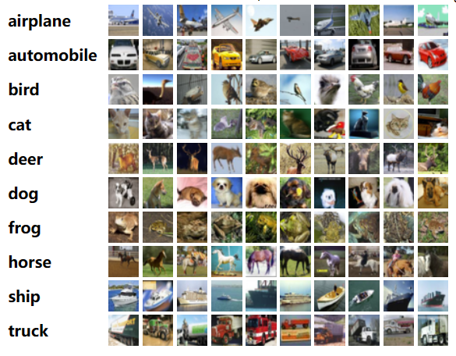
CIFAR-10 DataSet
The CIFAR-10 dataset consists of 60000 32x32 colour images in 10 classes, with 6000 images per class. There are 50000 training images and 10000 test images.
The dataset is divided into five training batches and one test batch, each with 10000 images. The test batch contains exactly 1000 randomly-selected images from each class. The training batches contain the remaining images in random order, but some training batches may contain more images from one class than another. Between them, the training batches contain exactly 5000 images from each class.
Ref: https://www.cs.toronto.edu/~kriz/cifar.html

Slide 11
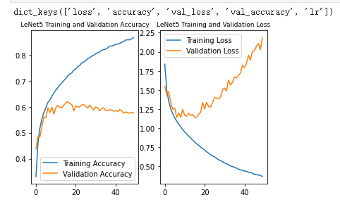
Experimental results of Lenet5
-Only about 60% accuracy rate.
-Overfitting of the model is quite serious.
-the accuracy rate of epochs has not been improved since it was increased from 50 to 180.

Slide 12
03
Alexnet

Slide 13
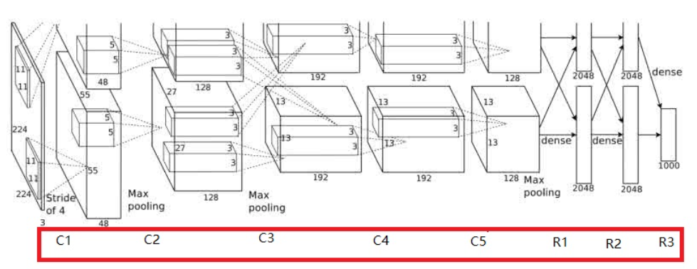
Five convolutional layer, three fully connected layer, a softmax output layer.
LRN LRN
The Local Response Normalization contributed a 1.2% extra accuracy rate.

Slide 14
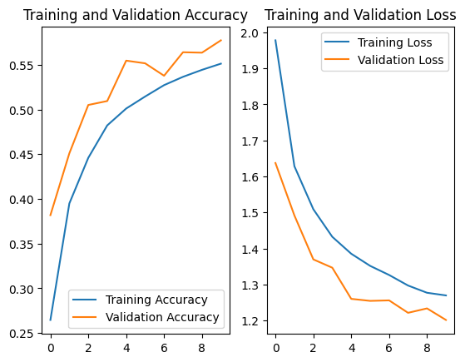

Slide 15
04
VGG Net
2030026117 QIAN Jingbin

Slide 16
VGGNet can be seen as an enhance version of AlexNet, consisting of five convolutional layer, three fully connected layer, a softmax output layer.

Slide 17
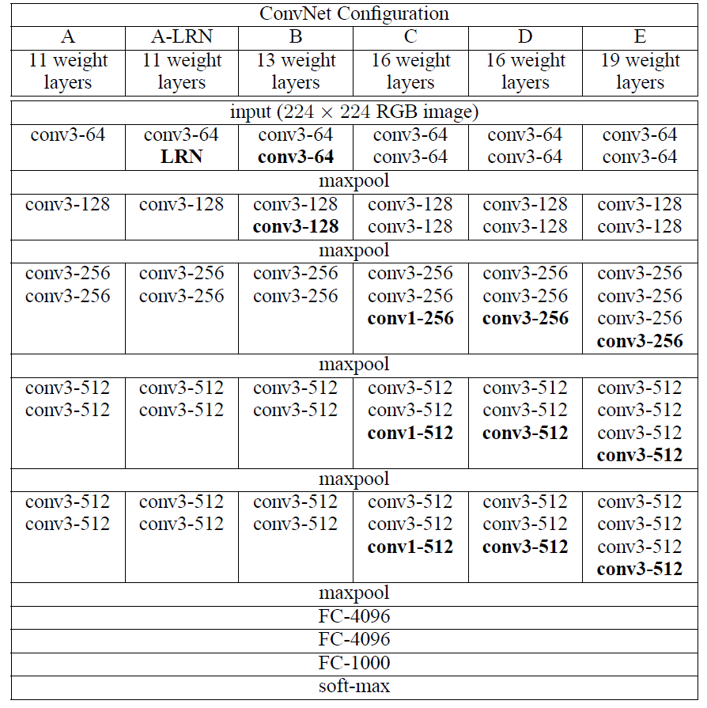
Although the number of layers is deeper, its structure is simple, and its convolution kernel is small than AlexNet.

Slide 18



Slide 19
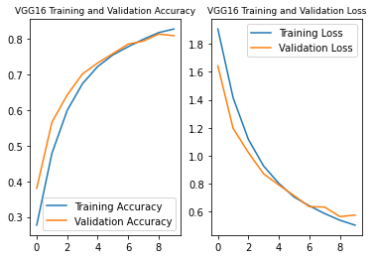
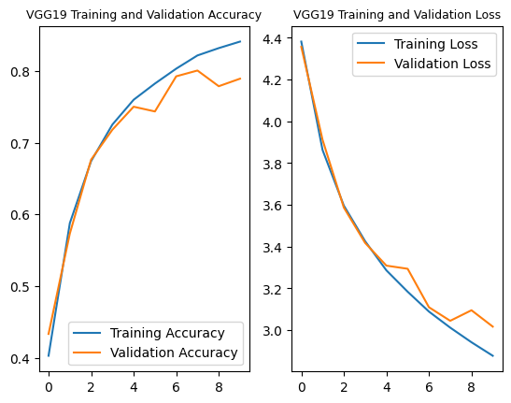
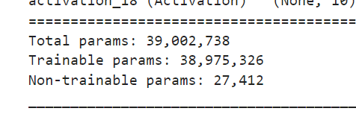
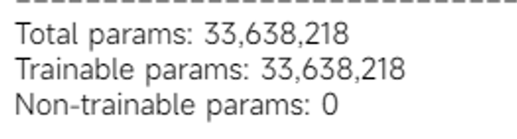
cifar-10

Slide 20
05
Resnet

Slide 21
Why was Resnet created?
Before Resnet was created, people simply relied on stacking neural network layers to achieve higher performance. Resnet solves the problem of gradient vanishing and gradient explosion to some extent.

Slide 22
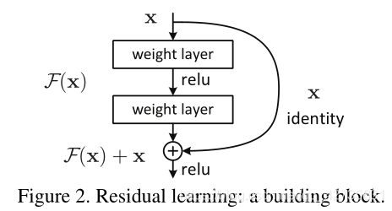
Residual Learning
Resnet adds an identical mapping layer so that the original input information can be transferred directly to the later layers.

Slide 23
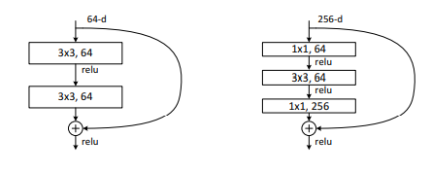
Residual Learning Unit
The residual learning unit is the actuator in resnet that allows the raw input information to be transmitted directly to the later layer.
On the left are the residual learning units of the two layers and on the right are the residual learning units of the three layers.

Slide 24
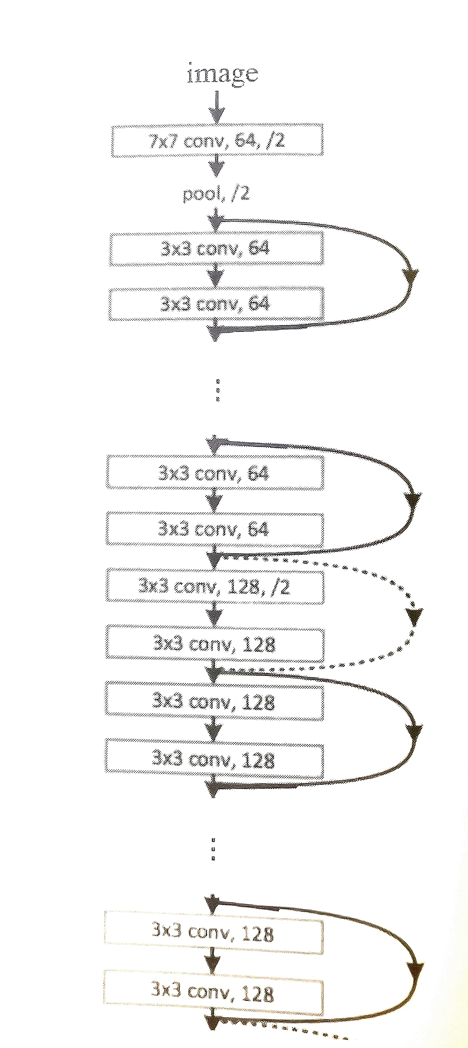
Resnet stacks the residual learning unit
Resnet has many side lines that directly participate the input of the previous residual learning unit into the output, so that the subsequent residual learning unit can directly learn the residual.

Slide 25
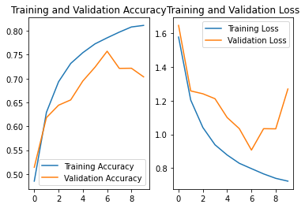
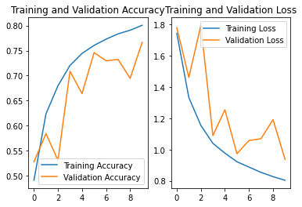
Resnet v1 & Resnet v2 CIFAR-10 Dataset

Slide 26
06
EfficientNet
Manage depth, width and resolution
FENG Ziao 2030026036

Slide 27
Model Scaling
Depth
02
Width
01
Resolution
03
Add more layers result in richer, more complex features,
Increase neural number in some specific layers to improve feature capture
Increase resolution may potentially get more fine geatures, but training speed will slow down

Slide 28
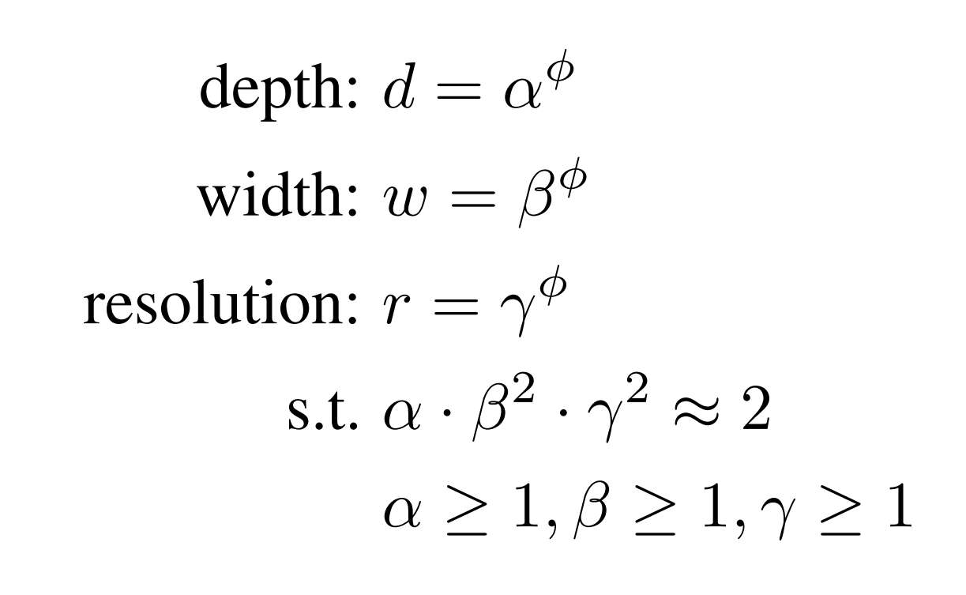
Compound Scaling Method
s.t. stands for restrict condition and α,β,γ are constraints that can use a small grid search to determine these optimal hyperparameter values
EfficientNet: Rethinking Model Scaling for Convolutional Neural Networks (ICML 2019)

Slide 29
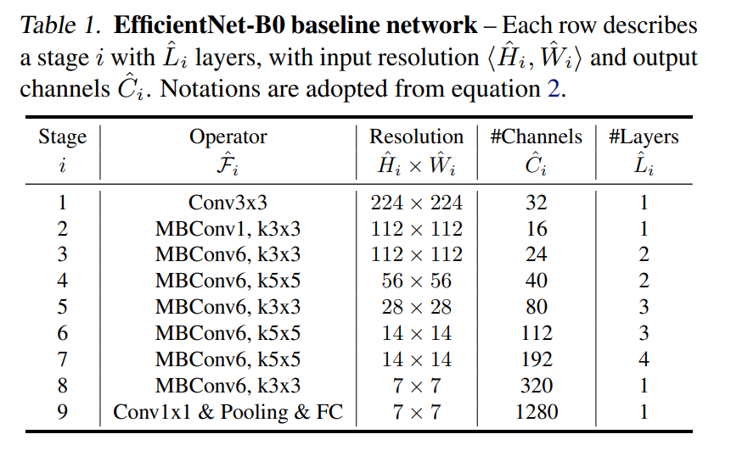
Compound Scaling Method
Use different φ can generate a family of EfficientNets name from EfficientNetB0 to EfficientNetB7
EfficientNet: Rethinking Model Scaling for Convolutional Neural Networks (ICML 2019)

Slide 30
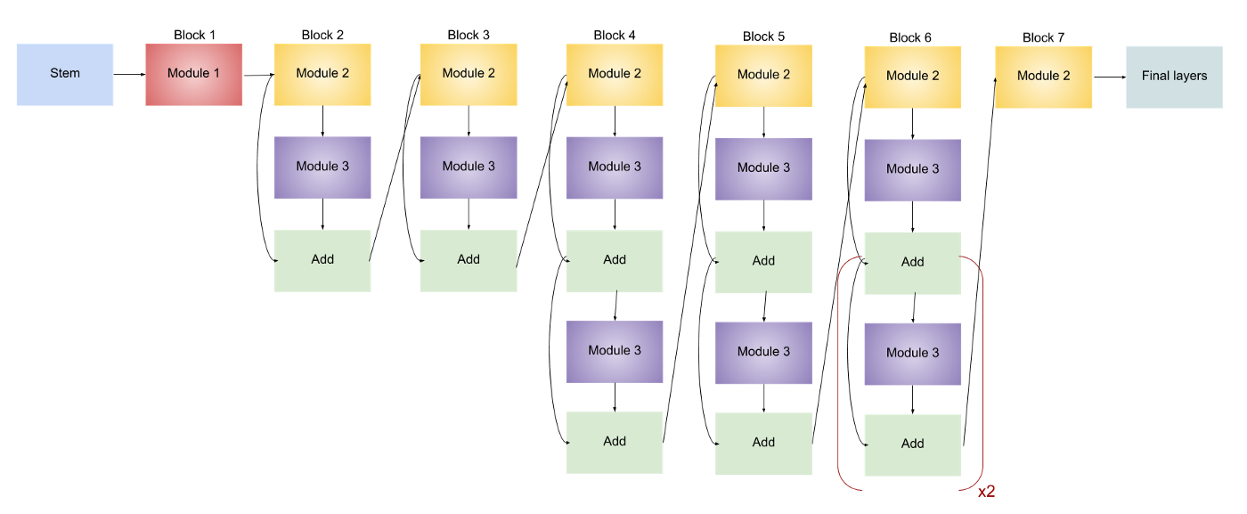
EffficientNetB0
EfficientNet: Rethinking Model Scaling for Convolutional Neural Networks (ICML 2019)

Slide 31
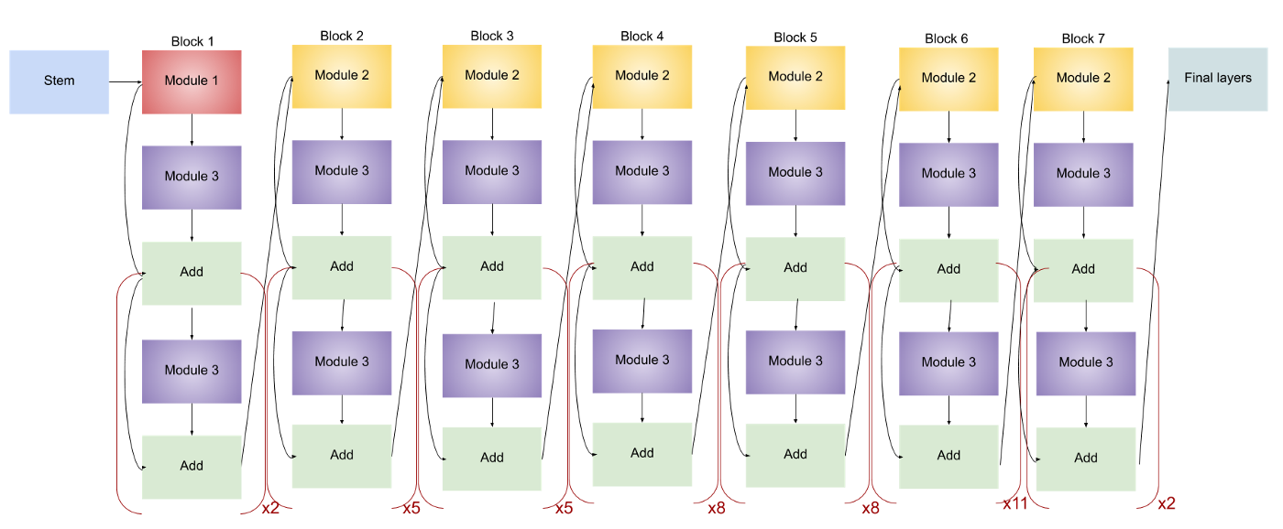
EffficientNetB7
EfficientNet: Rethinking Model Scaling for Convolutional Neural Networks (ICML 2019)

Slide 32
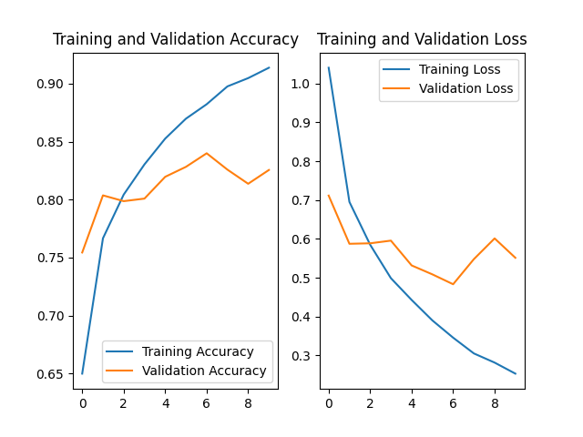
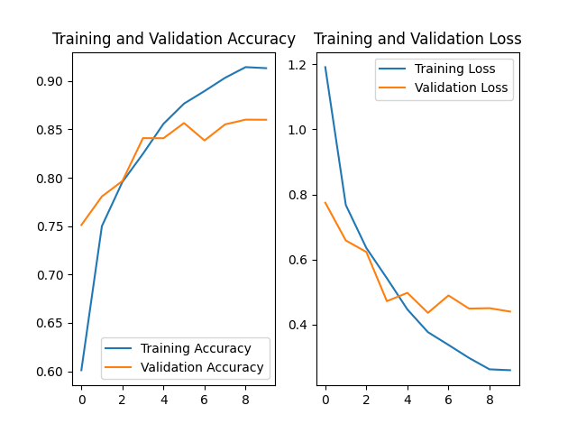
Experiment Results CIFAR-10 Dataset
EfficientNetB0 on CIFAR-10
EfficientNetB7 on CIFAR-10

Slide 33
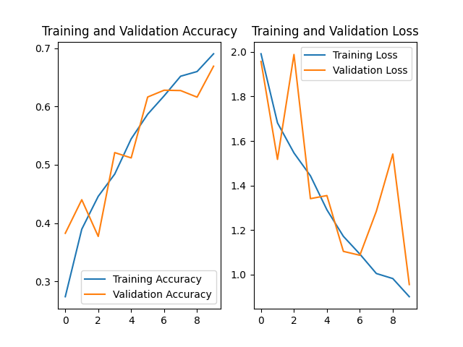
Experiment Results CIFAR-10 Dataset
EfficientNetB0 with pre-trained weights
random initialization

Slide 34
Application
07
A Image Recognizaation Application

Slide 35
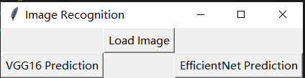

Slide 36
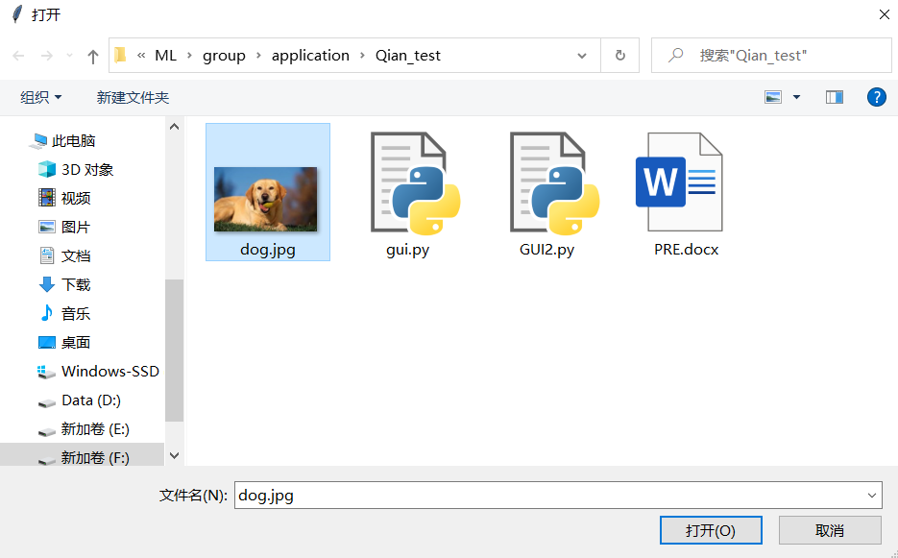

Slide 37
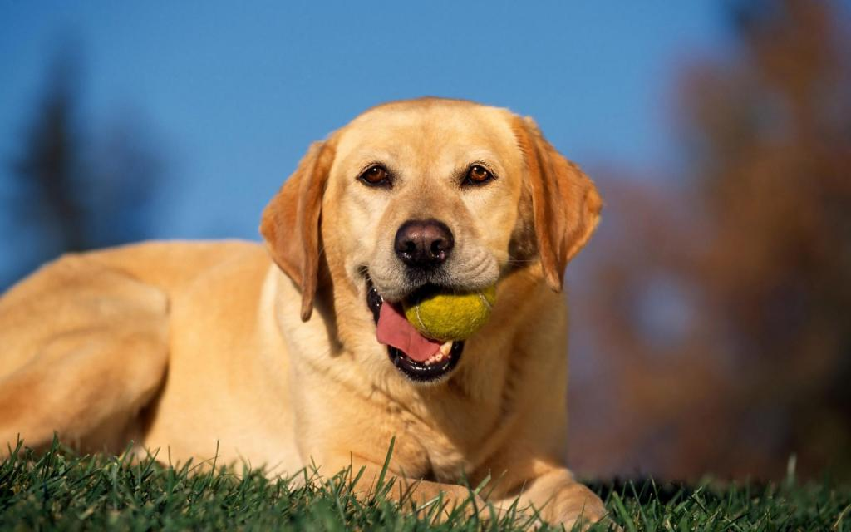
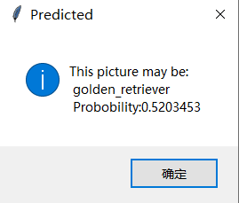
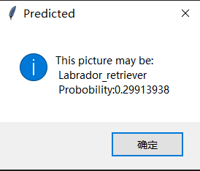
VGG16
EfficientNet

Slide 38
Conclusion
08

Slide 39
9
Reference

Slide 40
[1] Boureau Y L, Bach F, LeCun Y, et al. (2010). Learning mid-level features for recognition[J].
[2] Ciregan, D., Meier, U., &amp; Schmidhuber, J. (2012, June). Multi-column deep neural networks for image classification. In 2012 IEEE conference on computer vision and pattern recognition (pp. 3642-3649). IEEE.
[3] Frossard, D. (2016, June 17). VGG in TensorFlow: Model and Pre-trained Parameters for VGG16 in TensorFlow. Toronto. https://www.cs.toronto.edu/~frossard/post/vgg16/#introduction
[4] He, K., Zhang, X., Ren, S., and Sun, J. (2016). Deep residual learning for image recognition. CVPR, pp. 770–778
[5] Howard, A. G., Zhu, M., Chen, B., Kalenichenko, D., Wang, W., Weyand, T., Andreetto, M., and Adam, H. (2017). Mobilenets: Efficient convolutional neural networks for mobile vision applications. arXiv preprint arXiv:1704.04861,
[6] Hu, J., Shen, L., and Sun, G. (2018). Squeeze-and-excitation networks. CVPR
[7] HU J., SHEN L, ALBANIA Set al. (2020). Squeeze-and-Excitation Networks [J]. IEEE Transactions on Pattern Analysis and Machine Intelligence，42（8）：2011-2023.
[8] Huang, Y., Cheng, Y., Chen, D., Lee, H., Ngiam, J., Le, Q. V., and Chen, Z. (2018). Gpipe: Efficient training of giant neural networks using pipeline parallelism. arXiv:1808.07233,
[9] Hubel D. H., Wiesel T. N. (1962). Receptive fields, binocular interaction and functional architecture in the cat’s visual cortex[J]. The Journal of Physiology, 160(1): 106-154.
[10] Jiang, B. (2022). Image Classification Method Based on Improved ResNet Model. Modern Information Technology (12),83-85. doi: 10.19850/j.cnki.2096-4706.2022.012.021.
[11] Kaiming He,Xiangyu Zhang,Shaoqing Ren & Jian Sun 0001.(2015).Deep Residual Learning for Image Recognition. CoRR.
[12] Kaiming He,Xiangyu Zhang,Shaoqing Ren & Jian Sun 0001.(2016).Identity Mappings in Deep Residual Networks. CoRR.
[13] Kim Bubryur,Natarajan Yuvaraj,Munisamy Shyamala Devi,Rajendran Aruna,Sri Preethaa K. R.,Lee DongEun & Wadhwa Gitanjali.(2022).Deep Learning Activation Layer-Based Wall Quality Recognition Using Conv2D ResNet Exponential Transfer Learning Model. Mathematics(23). doi:10.3390/MATH10234602.
[14] Kornblith, S., Shlens, J., and Le, Q. V. (2019). Do better imagenet models transfer better? CVPR.

Slide 41
[15] Krizhevsky A., Sutskever I., Hinton G. E. (2012). Imagenet classification with deep convolutional neural networks[C]//Advances in neural information processing systems. 1097-1105.
[16] Krizhevsky, A., &amp; Sutskever, I., &amp; Hinton, G. (2017, June). ImageNet classification with deep convolutional neural networks. Communications of the ACM. 60(6), 84–90. https://doi.org/10.1145/3065386
[17] Krizhevsky, A., &amp; Hinton, G. (2010). Convolutional deep belief networks on cifar-10. Unpublished manuscript, 40(7), 1-9. https://www.cs.toronto.edu/~kriz/conv-cifar10-aug2010.pdf
[18] LeCun Y., Bottou L, Bengio Y, et al. (1998). Gradient-based learning applied to document recognition[J]. Proceedings of the IEEE, 86(11): 2278-2324.
[19] LeCun, Y., Kavukcuoglu, K., &amp; Farabet, C. (2010, May). Convolutional networks and applications in vision. In Proceedings of 2010 IEEE international symposium on circuits and systems (pp. 253-256). IEEE.
[20] Lee, H., Grosse, R., Ranganath, R., &amp; Ng, A. Y. (2009, June). Convolutional deep belief networks for scalable unsupervised learning of hierarchical representations. In Proceedings of the 26th annual international conference on machine learning (pp. 609-616). https://doi.org/10.1145/1553374.1553453
[21] Panda Manoj Kumar, Sharma Akhilesh, Bajpai Vatsalya, Subudhi Badri Narayan, Thangaraj Veerakumar & Jakhetiya Vinit.(2022).Encoder and decoder network with ResNet-50 and global average feature pooling for local change detection. Computer Vision and Image Understanding. doi:10.1016/J.CVIU.2022.103501.

Slide 42
[22] Sandler, M., Howard, A., Zhu, M., Zhmoginov, A., and Chen, L.-C.(2018). Mobilenetv2: Inverted residuals and linear bottlenecks. CVPR.
[23] Simonyan K, Zisserman A. (2014). Very deep convolutional networks for large-scale image recognition[J]. arXiv preprint arXiv:1409.1556.
[24] Simard, P. Y., Steinkraus, D., &amp; Platt, J. C. (2003, August). Best practices for convolutional neural networks applied to visual document analysis. In Icdar (Vol. 3, No. 2003).
[25] Szegedy, C., Liu, W., Jia, Y., Sermanet, P., Reed, S., Anguelov, D., ... &amp; Rabinovich, A. (2015). Going deeper with convolutions. In Proceedings of the IEEE conference on computer vision and pattern recognition (pp. 1-9).
[26] Tan, M., Chen, B., Pang, R., Vasudevan, V., Sandler, M., Howard, A., and Le, Q. V. (2019). MnasNet: Platform-aware neural architecture search for mobile. CVPR.
[27] Tan, M., & Le, Q.V. (2019). EfficientNet: Rethinking Model Scaling for Convolutional Neural Networks. ArXiv, abs/1905.11946.
[28] WANG Q. L., WU B. G., ZHU P. F. et al. (2020). ECA-Net： Efficient Channel Attention for Deep Convolutional Neural Networks [C]//2020 IEEE/CVF Conference on Computer Vision and Pattern Recognition （CVPR）. Seattle： IEEE，11531-11539.
[29] Werbos, P. (1974). Beyond regression:" new tools for prediction and analysis in the behavioral sciences. Ph. D. dissertation, Harvard University.
[30] WOO S，PARK J，LEE J Y. et al. (2022, Mar) CBAM: Convolutional Block Attention Module [J/OL].arXiv:1807.06521[cs.CV].https://arxiv.org/abs/1807.06521.
[31] Zagoruyko, S. and Komodakis, N. (2016). Wide residual networks. BMVC.
[32] Zhou Feiyan, Jin Linpeng, Dong Jun (2017). A survey of convolutional neural networks [J]. Journal of Computer Science, 40(6): 1229-1251.
[33] Zoph, B. and Le, Q. V. (2017). Neural architecture search with reinforcement learning. ICLR.

Slide 43
THANKS

